Slide 1
Evaluation & Clinical Assessment in Nursing Education
02808
Doctorate Program 2ndSemester2024-2025
Clinical Evaluation Methods
Prepared By:
Shimaa Awad
Samar Rady
Shereen Mohamed Sobhy
Under supervision of:
Prof. Dr/ Effat Mohammed Prof. Dr/ Enas Helmy
Prof. Dr/ Heba Ahmed

Slide 2
Objectives
At the end of group discussion each candidate will be able to:
Apply Criteria Selecting Clinical Evaluation Methods.
Discuss type evaluation methods which used in nursing education programs.
Differentiate between different types of clinical evaluation methods

Slide 3
Outline:
Introduction.
Purpose of clinical evaluation methods.
Factors to select clinical evaluation methods.
Clinical evaluation methods:
Observation.
Note clinical evaluation
Checklists.
Rating Scales.
Using Simulations for Clinical Evaluation.
Objective Structured Clinical Examination.
Objective Structured Practical Examination
Writing assignments.
Journal Writing.

Slide 4
Outline...Cont.,
Nursing Care Plans.
Concept Maps.
Case method, unfolding cases, and case study.
Games.
Media clips
Papers.
Portfolio.
Conferences.
Group projects.
Self-assessment.
Clinical evaluation in distance education.
Summery
References

Slide 5
Introduction
Clinical evaluation methods in nursing education are critical tools used to assess and ensure the competency of nursing students in both theoretical knowledge and practical skills. These methods provide a structured approach to measure students' progress, identify areas for improvement, and prepare them for real-world healthcare environments (Vijayan,2025)

Slide 6
Introduction.. Cont.,
These methods help educators evaluate various aspects, such as students’ knowledge, clinical judgment, communication skills, technical abilities, and professional behavior and ensure nursing students are prepared to deliver safe, effective, and compassionate patient care )Rana, Shagun, 2024).

Slide 7
Selecting Clinical Evaluation Methods
First,
The evaluation methods should provide information on student performance of the clinical competencies associated with the course.
The teacher collects data on performance to judge if students are developing the clinical competencies or have achieved them by the end of the course.

Slide 8
Selecting Clinical Evaluation Methods..cont.,
Second,
There are many different clinical evaluation strategies that might be used to assess performance.
Varying the methods maintains student interest and takes into account individual needs, abilities, and characteristics of learners.
It also avoids relying on one method, such as a rating scale, for determining the entire clinical grade.

Slide 9
Selecting Clinical Evaluation Methods..cont,.
Third, the teacher should always select evaluation methods that are realistic considering:
The number of teacher /students ratio to be evaluated.
Available practice or simulation activities.
constraints such as the teacher’s or preceptor’s time.

Slide 10
Selecting Clinical Evaluation Methods..cont,.
Fourth, evaluation methods can be used for either formative or summative evaluation.
Formative clinical evaluation, the focus is on the progression of students in meeting the learning goals.
Summative evaluation establishes whether the student met those goals and is competent at the end of the rotation, course, or semester.

Slide 11
Selecting Clinical Evaluation Methods..cont,.
Fifth, before finalizing the protocol for evaluating clinical performance in a course:
The teacher should review the purpose of each assignment completed by students in clinical practice and should decide on how many assignments will be in the course.
Sixth, in deciding how to evaluate clinical performance, the teachershould consider the time needed to complete the evaluation, provide feedback, and grade the assignment.

Slide 12
Classification of clinical evaluation methods
Classification of clinical evaluation methods

Slide 13
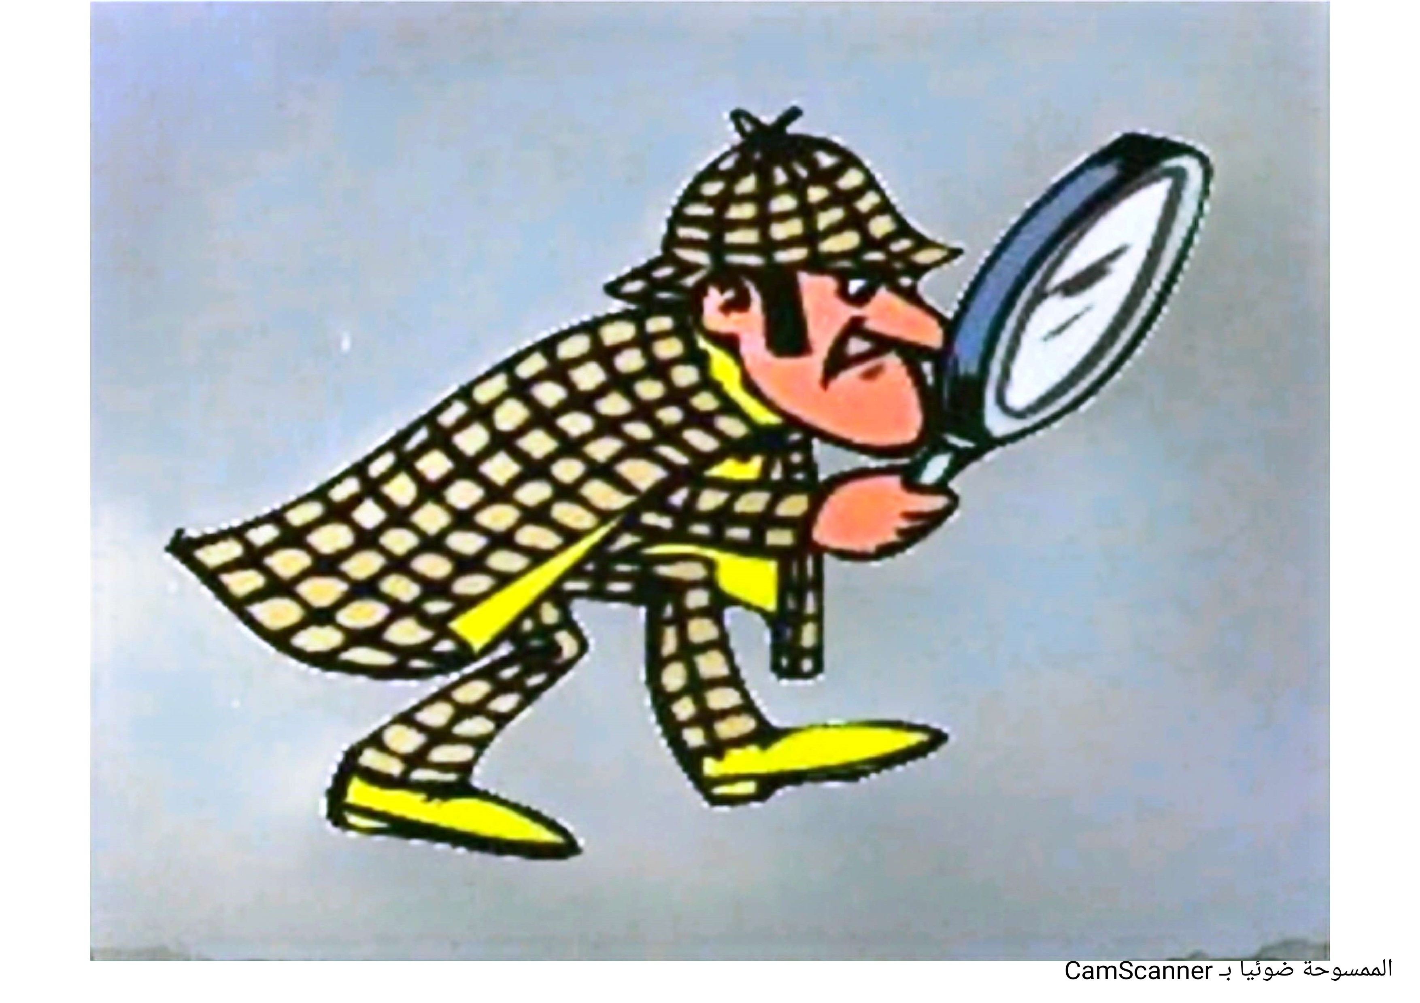
Observational Techniques
The predominant strategy for evaluating clinical performance is observing students in clinical practice, simulation and learning laboratories, and other settings.

Slide 15
Observational Techniques ..cont.,
Observation is widely used, there are threats to its validity and reliability:
Observations of students may be influenced by the teacher’s values, attitudes, and biases.
Over-reliance on first impressions .
Observing performance, there are many aspects of that performance on which the teacher may focus attention.
The teacher may arrive at incorrect judgments about the observation Every observation in the clinical setting reflects only a sampling of the learner’s performance during a clinical activity.

Slide 16
Types of observational techniques:
Anecdotal records
Checklists
Rating scales

Slide 17
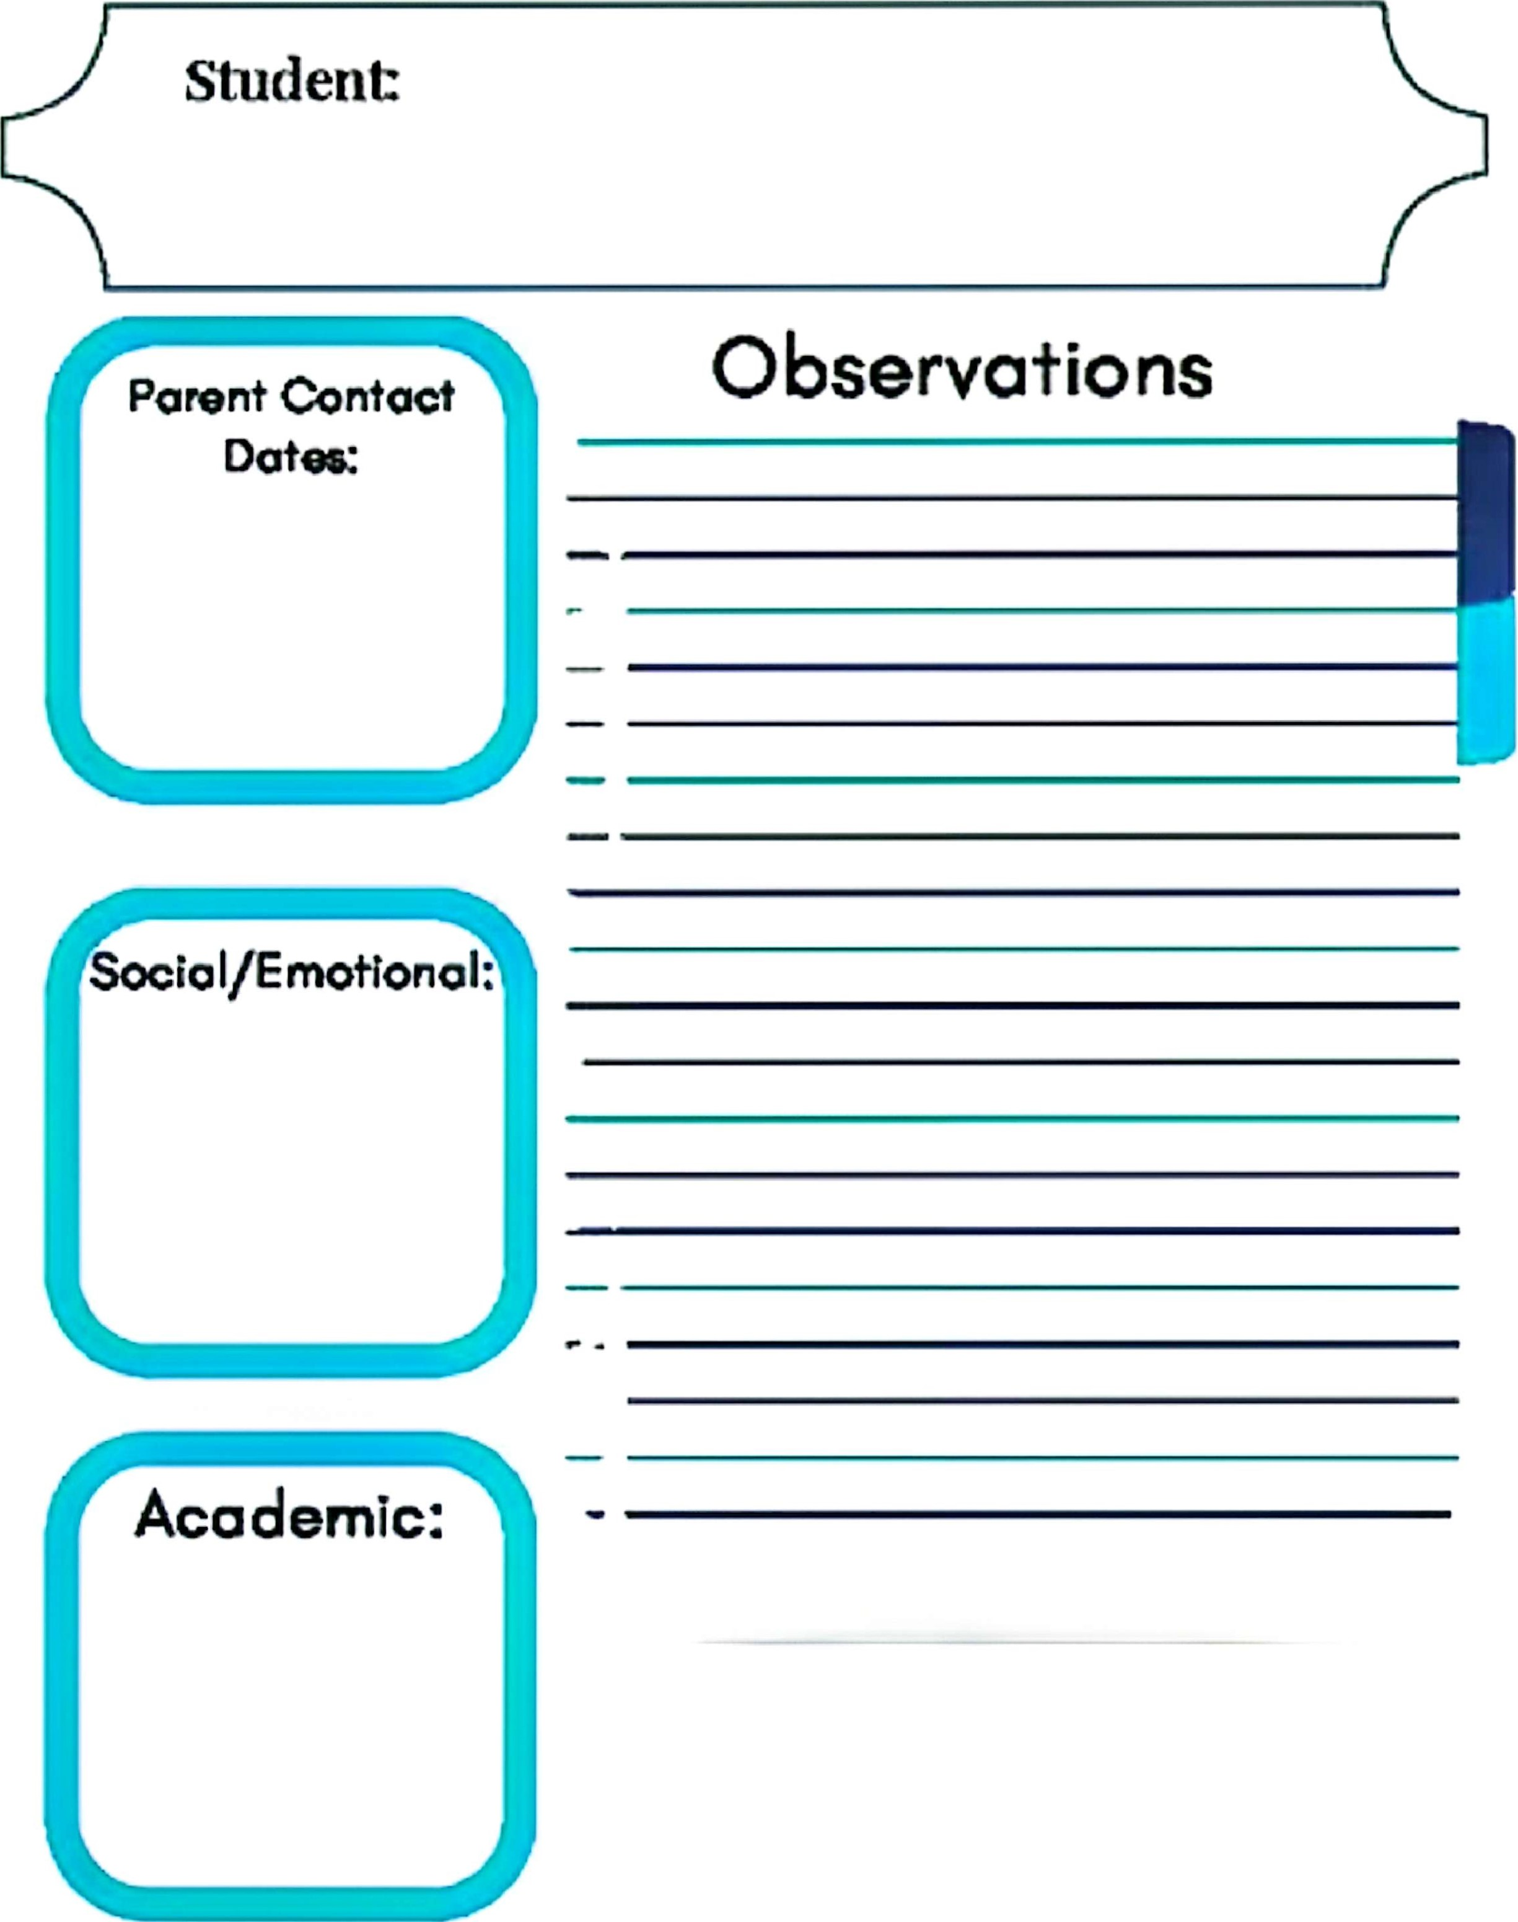
Types of Observational tools. cont.,
Notes About Performance
Anecdotal Notes:
Used for recording descriptions of observations made of students in the clinical setting.
May also include interpretations or conclusions about the performance.
Should be shared with students as frequently as possible.

Slide 18
Types of Observational tools. cont.,
Notes About Performance should include :
Date of the observation
Student name
Faculty signature
Setting of the observation,
Record of situation, behavior of student, actions, reaction.
Good and bad things ,conclusion and interpretation of performance.

Slide 20
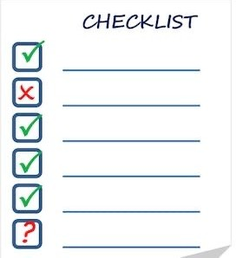
Types of Observational tools. cont.,
Checklists
Checklists are used frequently in health care settings to assess skills of nurses and document their continuing competence in performing them.
Used primarily for recording observations of specific competencies, procedures, and skills performed by students.

Slide 21
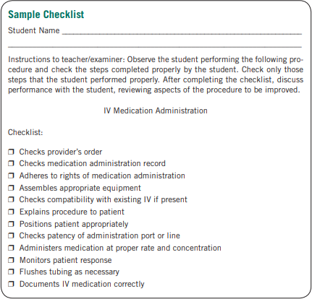

Slide 22
Types of Observational tools. cont.,
CHECKLIST
A check list consists of steps activities or behaviour which the observer records when an incident occurs.
A check list enables the observer to note whether or not a trait or characteristic is present. They can be used when components of competence specified. A two column format is often used.

Slide 23
Types of Observational techniques. Cont.,
Rating Scales
Used for recording judgments about students’ performance in clinical practice.
Includes a set of defined clinical outcomes, behaviors, or competencies and scale for rating the degree of competence (with multiple levels or pass–fail).
A rating scale resembles a checklist but in this instead of merely indicating the presence or absence of a trait or characteristic , it enables us to indicate the degree to which the trait is present .

Slide 24
Types of Observational techniques. Cont.,
Types of Rating Scales:
Dichotomous :simple attitude rating scale ,agree or disagree ,yes or no
Category scale , Letters: A, B, C, D, E or A, B, C, D, F.
Numbers: 1, 2, 3, 4, 5.
Qualitative labels: Excellent, very good, good, fair, and poor; Exceptional, above average, average, and below average
Frequency labels: Always, usually, frequently, sometimes, and never.

Slide 25
Rating Scale

Slide 28
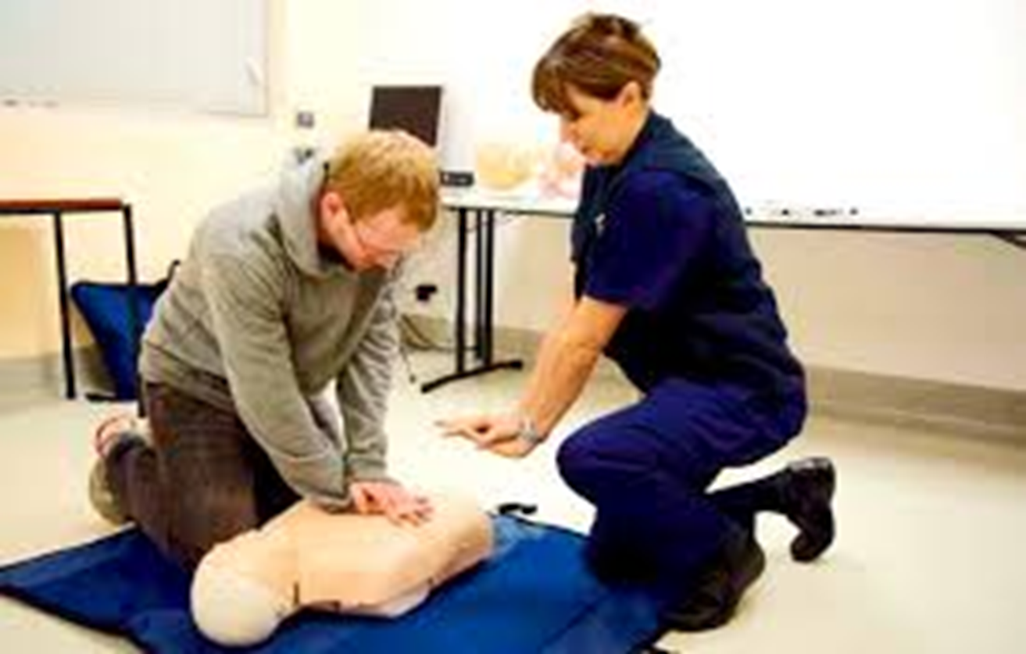
Simulation
Simulation is an event or activity that allows learners to experience a clinical situation without the risks.
Simulations are being used more frequently in clinical settings with new graduates and experienced nurses.

Slide 29
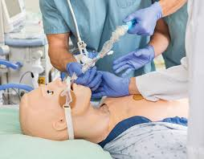
Simulation. Cont.,
Scenarios ease the shortage of clinical experiences for students because of clinical agency restrictions and fewer practice hours in a curriculum
Simulations do not replace actual experiences with patients and learning that results from partnering with preceptors.

Slide 30
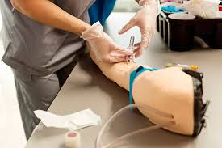
Benefits of stimulation include :
Students can develop their psychomotor and technological skills and practice those skills to maintain their competence.
Human patient simulators, enable students to gain thinking and problem-solving skills, and make independent decisions.
Simulations speed learning of didactic content and development of skills.

Slide 31
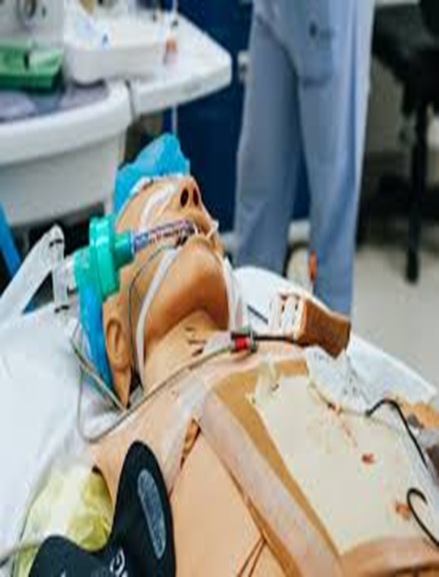
Simulation
Benefits of stimulation include :
4. Students can assess a patient or clinical situation, analyze data, make decisions about priority problems and actions to take, implement those interventions, practice complex technologies, and evaluate outcomes.

Slide 32
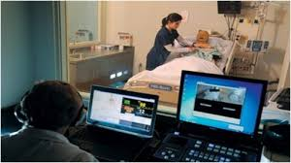
Types of simulations:
Case scenarios that students analyze can be presented in paper-and-pencil format or through multimedia.
Computer simulations can be developed with models and manikins for evaluating skills and procedures, and for evaluation with standardized patients.

Slide 33
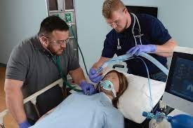
Human Patient Simulators
Human Patient Simulators are computerized manikins that can replicate a wide range of physiological functions such as breathing, heart sounds, pulses, and even medical emergencies. These simulators allow students to practice and be evaluated on clinical procedures, and decision-making in a controlled environment.

Slide 34
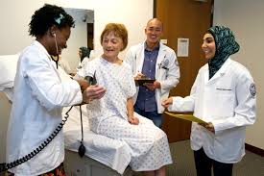
Standardized patients
One type of simulation for clinical evaluation uses standardized patients.
Standardized patients contribute to consistency in evaluations by accurately simulating patient conditions.
Evaluation tools used with standardized patients should be valid and reliable to ensure a comprehensive assessment of students' abilities.

Slide 35
Objective Structured Clinical Examination

Slide 36
Objective Structured Clinical Examination
O – Objective: Based on facts, not personal feelings or bias. Every student is evaluated using the same checklist or criteria
S – Structured: Carefully organized and planned. The exam follows a predefined format with set stations, timings, and instructions.
C – Clinical: Related to real-life patient care or healthcare settings. It tests clinical skills like examining a patient diagnosing, or performing a procedure.
E – Examination: A formal test to assess knowledge or skills. It’s an assessment method to evaluate how well a student performs various clinical tasks (Dewan, Khalil & Gupta, 2024).

Slide 37
Objective Structured Clinical Examination
OSCEs are structured assessments that involve multiple stations, each focusing on a specific clinical skill or scenario. Students rotate through these stations and perform tasks while being observed and evaluated. OSCEs often use checklists and rating scales to assess students' performance, communication, and clinical reasoning (Ahmed & Khan, 2023).

Slide 38
Objective Structured Clinical Examination
Some stations assess the student’s ability to take a patient’s history, perform physical examination, and implement other interventions while being observed by the teacher or an examiner.
At other stations, students might be tested on their knowledge and cognitive skills—they might be asked to analyze data, select interventions and treatments, and manage the patient’s condition.

Slide 39
Types of OSCE stations:
1- At clinical stations the focus is on clinical competence, for example, taking a history and performing a physical examination, collecting appropriate data, and communicating effectively.
Typically at clinical stations there is interaction between the student and a simulated patient.
At these stations the teacher or examiner can evaluate students’ understanding of varied patient conditions and management of them and can rate the students’ performance.

Slide 40
Types of OSCE stations:
2- At practical stations students demonstrate psychomotor skills, per
form procedures, use technologies, and demonstrate other technical
competencies.
Performance at these stations is evaluated by the teacher or examiner, usually with checklists.
Challenges in using OSCE are student stress from being observed during performance.

Slide 41
Types of OSCE stations:
3- Static station, this station facilitates the evaluation of cognitive skills such as interpreting lab results and other data, developing management plans, and making other types of decisions about patient care.
At these stations the teacher or examiner is not present to observe students.
There is no interaction with a simulated or standardized patient.

Slide 43
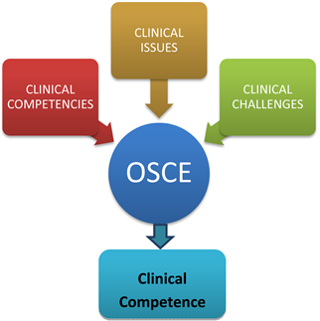
Objective Structured Clinical Examination

Slide 44
Objective Structured Practical Examination
An Objective Structured Practical Examination (OSPE) is a new pattern of practical examination. In OSPE each component of clinical competence is tested uniformly and objectively for all the students who are taking up a practical examination at a given place (Singh, Sood & Singh, 2020).

Slide 45
Objective Structured Practical Examination
An Objective Structured Practical Examination (OSPE) in nursing is an assessment method that evaluates a student's clinical and practical skills in a structured manner. During an OSPE, nursing students move through a series of stations, each presenting a specific scenario or task related to clinical practice.

Slide 46
Objective Structured Practical Examination
They are then assessed on their ability to perform relevant nursing procedures, make decisions, and apply their knowledge in a hands-on setting. This format allows for a comprehensive evaluation of practical skills in a standardized and objective way.

Slide 47
OSPE

Slide 48
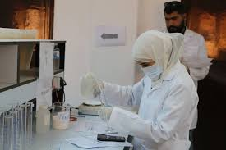
Objective Structured Practical Examination

Slide 49
Written Assignments in Clinical Evaluation
Written assignments accompanying the clinical experience are effective methods for assessing :
Students’ problem solving.
Critical thinking.
Higher level learning.
Understanding of content relevant to clinical practice.
Ability to express ideas in writing.

Slide 50
Written Assignments in Clinical Evaluation
Written assignments should be assessed using predetermined criteria that address quality of content; organization of ideas; and the process of arriving at decisions and, depending on the assignment, at developing an argument. Writing style should also be considered.
The teacher needs to be clear about the outcomes to be evaluated with the assignment.

Slide 51
Written Assignments in Clinical Evaluation
Structured assignments that involve short sentences and phrases, such as nursing care plans and teaching plans, do not foster development of writing skills, nor do they provide data for assessing writing.
Other assignments such as papers on analyses of theories and critiques of the literature can be used for assessing students’ understanding as well as writing ability.

Slide 52
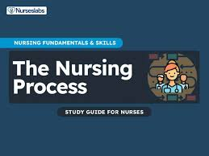
Nursing Care Plans
Nursing care plans enable the student to learn the components of the nursing process and how to use the literature and other resources for writing the plan.
linear kind of care planning does not help students learn how problems interrelate nor does it encourage the complex thinking that nurses must do in clinical practice

Slide 53
Nursing Care Plans
Short assignments in which students analyze data, examine competing diagnoses, evaluate different interventions and their evidence for practice, suggest alternative approaches, and evaluate outcomes of care are more effective than a care plan that students often paraphrase from their textbooks.

Slide 54
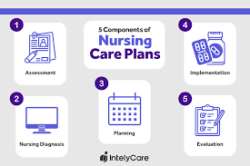
Nursing Care Plans

Slide 55
Journal Writing in Clinical Evaluation
Encouraging students to maintain reflective journals allows them to document their experiences, thoughts, and self- assessments. As a teacher, can review their journals periodically, providing feedback and guidance for further development.

Slide 56
Journal Writing in Clinical Evaluation
Journals are not intended to develop students’ writing skills; instead they provide a means of expressing feelings and reflections on clinical practice and engaging in a dialogue with the teacher about them.
When journals are used for reflection, they encourage student to make connections between theoretical knowledge and clinical observations and practice.

Slide 57
Journal Writing in Clinical Evaluation
Journals are not the same as diaries and logs:
In a diary, students document their experiences in clinical practice with personal reflections; these reflections are meant to remain “personal” and thus are not shared with the teacher or others.
A log is typically a structured record of activities completed in the clinical course without reflections about the experience.

Slide 58
Concept Maps in Clinical Evaluation
Concept maps are tools used to visually display relationships among concepts.
Concept maps are an effective way of :
Helping students organize data as they plan for their clinical experience.
Developed in a preclinical conference based on the patient’s admitting diagnosis, revised during the clinical day
Assessed and discussed in post clinical conference

Slide 59
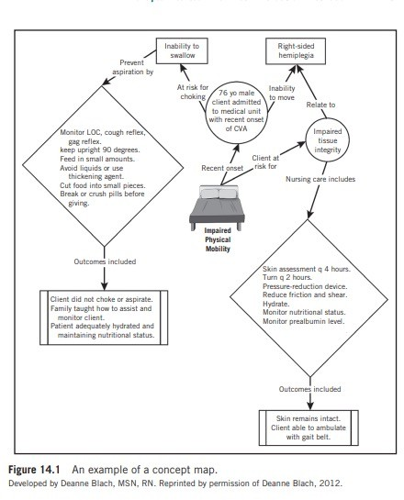
Concept Map

Slide 60
.
Case Method, Unfolding Cases, And Case Study
Case Method: Focuses on analysis, discussion, and decision-making based on a specific scenario.
Purpose: Enhances critical thinking and application of knowledge.
Unfolding Cases: A scenario that evolves over time with new information.
Purpose: Develops clinical reasoning and adaptability.
Case Study: An in-depth analysis of a real or hypothetical situation.
Purpose: Integrates theory with real-world practice

Slide 62
Case Method, Unfolding Cases, And Case Study
The focus might be on :
Identifying problems and possible approaches
Making decisions after weighing the options
Planning additional data to collect
Applying concepts and theories from class and readings to the case
Examining the case from different points of view
Identifying actions to take.

Slide 63
Case Method, Unfolding Cases, And Case Study. cont.,
Assignments may be completed as individual activities, they are also appropriate for group work.
Using this approach, cases are effective for encouraging critical thinking
With this method, the teacher can provide feedback on the content and thought process used by students to arrive at their answers.

Slide 64
Media Clips in Clinical Evaluation
Media clips: are short video or audio segments—often sourced from clinical settings, documentaries, movies, interviews, or even social media—that highlight specific healthcare scenarios or concepts.
A basis for discussions in post clinical conferences and used for small-group activities; and critiqued by students as an assignment.
Students can answer questions about the media clips as part of a graded learning activity.

Slide 65
Media Clips in Clinical . Cont.,
Media clips often are more effective than written descriptions of a scenario because they allow students to visualize patient scenarios, making them more engaging and effective.
It's essential to keep the clips short ,so they can focus on critical aspects related to the outcomes to be evaluated.

Slide 66
Media Clips in Clinical . Cont.,
Media clips are valuable for formative evaluation, especially in group
settings where students can discuss ideas and receive feedback from both teachers and peers.

Slide 67
Games in clinical evaluation
Games are teaching methods that involve competition, rules and
collaboration among team members.
Games actively engage learners, encourage teamwork, promote teamwork, use problem-solving skills, motivate, stimulate interest in a topic

Slide 68
Games in clinical evaluation
Games are not intended for grading; they should be used only
for instructional purposes and formative evaluation

Slide 69
Process Recording in clinical : A process recording is A written or recorded document that details A student's interaction with A patient or A simulated clinical scenario, includes the student's thoughts and feelings, and reflections on the interaction

Slide 70
Process Recording in clinical cont.,
Provide a way of evaluating students’ ability to analyze interactions they have
had with patients or in simulated clinical activities.
Process recordings are useful for providing feedback to students about their interactional skills, but the analysis of the communication also may be graded.

Slide 71
Process Recording in clinical cont.,
For distance education courses, they provide one source of information about student learning in clinical practice and development of communication skills.

Slide 72
Short Papers in Clinical evaluation
Short papers for assessing critical thinking and other cognitive skills The short paper, students are given a specific patient data set and are tasked with identifying patient problems based on the provided information

Slide 73
Short Papers in Clinical evaluation
Short papers aim to showcase students' critical thinking skills in assessing
Patient data, recognizing problems, and determining the need for additional information.

Slide 74
Portfolio in Clinical evaluation
A portfolio is a collection of projects and materials developed by the student that document achievement of the objectives of the clinical course.
It allows students to demonstrate what they have learned in clinical practice and the competencies they have developed.

Slide 75
Types Of Portfolios in Clinical evaluation:
1- Learning Portfolio (Formative):
Purpose: To document progress and learning over time
Contents: Journals or reflections , Clinical experiences, Skills checklists , Feedback from instructors
Use: Helps students self-assess, track goals, and engage in reflective practice
Best for: Ongoing development during a course or clinical rotation
2. Assessment Portfolio (Summative) :
Purpose: To evaluate achievement of course/program outcomes.
Contents: Case studies Clinical evaluations Written assignments Objective Structured Clinical Examinations (OSCEs)
Use: Used by faculty for grading or accreditation reviews
Best for: End-of-program evaluation or capstone projects

Slide 76
Types Of Portfolios in Clinical evaluation cont.,
3-Reflective Portfolio
Purpose: To encourage critical thinking and reflection on experiences
Contents: Reflective journals, Significant learning moments , Patient care narratives , Ethical dilemmas and responses.
Use: Fosters self-awareness and professional identity formation.
Best for: Personal and professional growth
4. Professional Portfolio
Purpose: To showcase competencies and achievements to employers or licensing bodies.
Contents: Resume, certifications, Continuing education certificates, Letters of recommendation Evidence of leadership or quality improvement projects
Use: For job interviews, promotions, or professional development.
Best for: Graduate nurses, practicing RNs, or advanced practice nurses

Slide 77
Types Of Portfolios in Clinical evaluation cont.,
Digital/E-Portfolio:
Purpose: A modern, accessible version of any portfolio type, Track growth across courses and clinicals,
Platform: Web-based tools like Google Site.
Benefits: Multimedia integration (videos, images) , Easy sharing and feedback, Environmentally friendly.
Use: Ideal for hybrid or online nursing programs

Slide 78
Faculty members should follow steps to determine portfolio is an appropriate evaluation method for the course:
Step1, Identify the purpose of the portfolio.
Step2, Identify the type of content to be included in the portfolio.
Step3 ,Decide on the evaluation of the portfolio entries including criteria for evaluation of individual entries and the portfolio overall.

Slide 79
Electronic Portfolios
Portfolios can be developed and stored electronically, which facilitates updating and revising entries, as compared with portfolios that include hard copies of materials.
Reasons in a for using electronic portfolios course:
They can be shared with others at limited or no cost (e.g., on the Web) and updated easily.
They can document learning and development over a period of time.

Slide 80
They can be modified for class and program assessment, graduation requirements, or a job search.
They can include a variety of multimedia

Slide 81
Conferences in Clinical evaluation
Oral communication skills are a crucial outcome of clinical practice in nursing.
These skills include presenting ideas orally, sharing patient information, leading discussions on clinical practice, and giving various types of
presentations.
Conferences serve as a method for developing and evaluating oral communication skills in nursing students.

Slide 82
Types of Conferences in Clinical evaluation:
A- Preclinical conferences:
Occur before clinical learning activities or simulations, allowing students to clarify their understanding of patient problems and interventions.
B- Postclinical conferences:
take place at the end of a clinical learning activity, provide an opportunity for the teacher to assess students' ability to apply concepts and theories in patient care, plan care, and think critically.

Slide 83
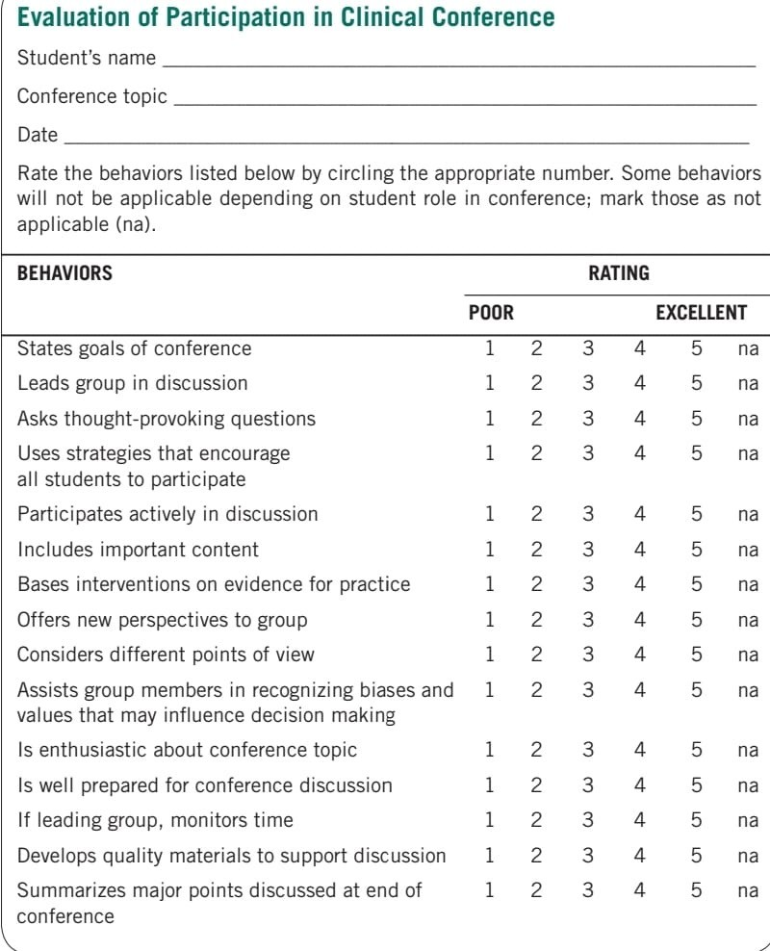

Slide 84
Group Projects in Clinical evaluation
Regarding the assessment of group projects as part of clinical evaluation in a nursing course .
Focus on Individual and Group Performance:
While many clinical evaluation methods emphasize individual student performance, group projects can also be assessed as part of the evaluation process.

Slide 85
Group Projects in Clinical evaluation
Group projects may vary in duration, ranging from short-term collaborations to long-term cooperative learning experiences.
Short-term projects may involve the development of products like posters or group presentations.
Long-term group work could entail students collaborating in small groups or teams over an extended period within the clinical practice setting.

Slide 86
Self-assessment in Clinical evaluation
The ability of students to evaluate their own clinical competencies and identify where further learning is needed
self-assessment begins with the first clinical course and develops throughout the nursing education program, continuing into professional practice.
Through self assessment, students examine their clinical performance and identify both strengths and areas for improvement.

Slide 87
Clinical Evaluation In Distance Education
Nursing education programs use different strategies for offering the clinical component of distance education courses. Often preceptors in the local area guide student learning in the clinical setting and evaluate performance.

Slide 88
Summary
Clinical evaluation methods assess student competencies in clinical practice. Teachers choose methods that provide information on performance and decide if they are formative or summative. clinical evaluation methods are diverse, serving formative or summative purposes. Feedback-focused methods contribute to ongoing learning, while summative assessments provide a comprehensive judgment.

Slide 89
References
Dewan, P., Khalil, S., & Gupta, P. (2024). Objective structured clinical examination for teaching and assessment: Evidence-based critique. Clinical Epidemiology and Global Health, 25, 101477. https://doi.org/10.1016/j.cegh.2023.101477
Singh, A., Sood, R., & Singh, R. (2020). Objective Structured Practical Examination (OSPE) as a tool for the formative assessment of practical skills in the subject of physiology: A comparative cross-sectional analysis. Advances in Physiology Education, 44(2), 223–228. https://doi.org/10.1152/advan.00123.2019
Ahmed, M., & Khan, R. (2023). Objective structured clinical examination for teaching and assessment: Evidence-based critique. Clinical Epidemiology and Global Health, 21, 101477.

Slide 90
References
Vijayan:(2025 Evaluation methods in clinical teaching.SlideShare. Retrieved April 11, 2025, from [SlideShare](https://www.slideshare.net/slideshow/evaluation-methods-in-clinical-teaching-pptx /271554563.
Rana, Shagun (2024): Clinical Evaluation.SlideShare, n.d., [SlideShare](https://www.slideshare.net/slideshow/seminar-clinical-evaluation /247788081.
Patidar, T. (2019, April 6). Clinical Evaluation Methods. Retrieved from [SlideShare](https://www.slideshare.net/tanojpatidar/clinical-evaluation-methods).
https://www.nln.org/education/teaching-resources/professional-development-programsteaching-resourcesace-all/ace-s/unfolding-cases

